Slide 1


Department of Computer Science and Engineering
AGE-RELATED MACULAR DEGENRATION(AMD)
CLASSIFICATION USING DEEP LEARNING AND
GAN TECHNOLOGY
B21A2425C01
LAKSHMIKANTH M (210701130)
NANDHAKUMAR S(210701172)
Mrs. ANANDHI S, M.E
Assistant Professor, CSE

Slide 2
Problem Statement and Motivation
The challenge in AMD classification lies in accurately determining the stage and severity of age-related macular degeneration to ensure timely treatment. Early detection and precise monitoring are critical, as they significantly influence the effectiveness of interventions. The primary motivation for developing advanced classification systems is to improve patient outcomes by enabling personalized treatment strategies.
Motivation: Current systems lack precision, driving the need for advanced models like Vision Transformers and EfficientNet. These models can significantly enhance classification accuracy, enabling personalized treatment strategies and better management of AMD.

Slide 3
Objectives
Expand Dataset: Collect a diverse and high-quality OCT image dataset.
Advanced GAN Models: Use advanced GAN architectures for synthetic image generation.
State-of-the-Art Models: Replace DeepSeeNet with Vision Transformers or EfficientNet.
Multi-Modal Integration: Combine OCT images with patient demographics and clinical history.
Refine Preprocessing: Enhance OCT image quality with improved noise reduction and artifact removal.

Slide 4
Abstract
In this study, we aim to improve Age-Related Macular Degeneration (AMD) severity classification by leveraging Optical Coherence Tomography (OCT) images, advanced Generative Adversarial Networks (GANs), and cutting-edge deep learning models, including Vision Transformers and EfficientNet. By refining image preprocessing techniques to enhance OCT image quality and combining multimodal data, our approach achieves higher accuracy and robustness. This integration of advanced AI methods not only enables early detection but also supports more effective management of AMD. The results underscore the potential of AI-driven solutions in advancing clinical ophthalmology and enhancing patient outcomes through personalized care.

Slide 5
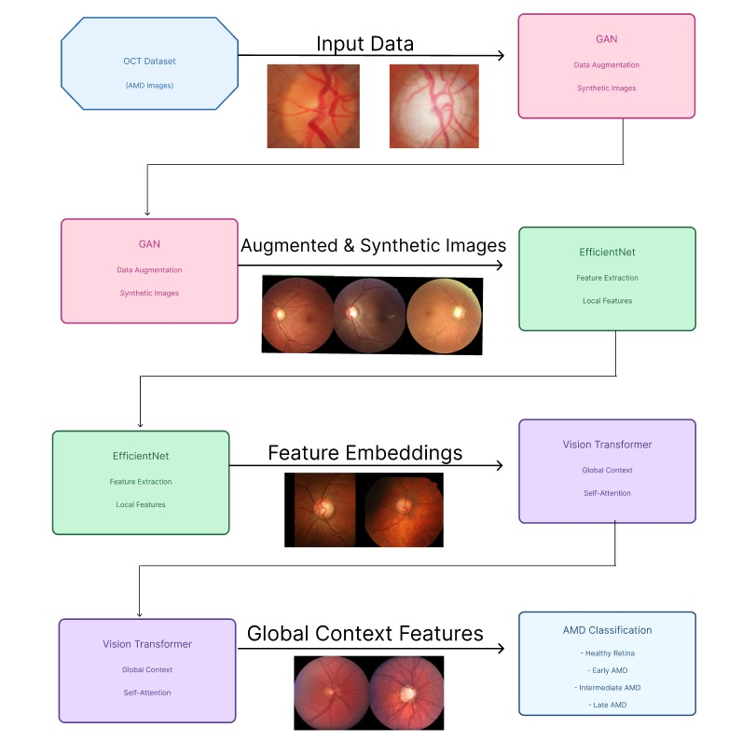
System Architecture

Slide 6
List of Modules
GAN TECHNOLOGY
VISION TRANSFORMER
EFFICIENT NET

Slide 7
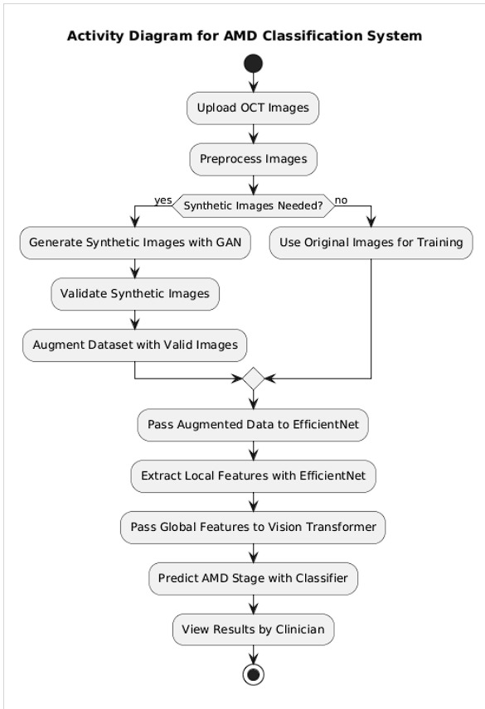
Functional Description for each modules with DFD and Activity Diagram
Activity Diagram

Slide 8
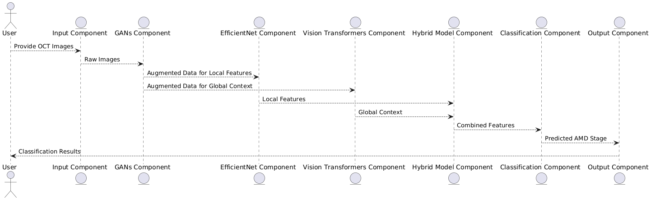
DFD
Data Flow Diagram

Slide 9
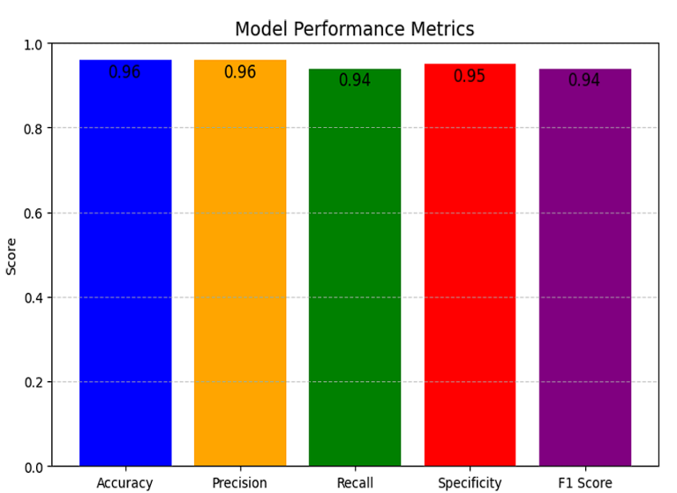
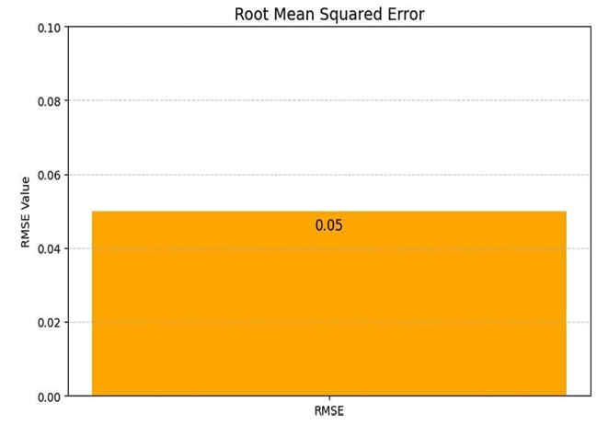
Implementation & Results of First Module
PERFORMANCE METRIX ROOT MEAN SQUARED ERROR [RMSE]

Slide 10
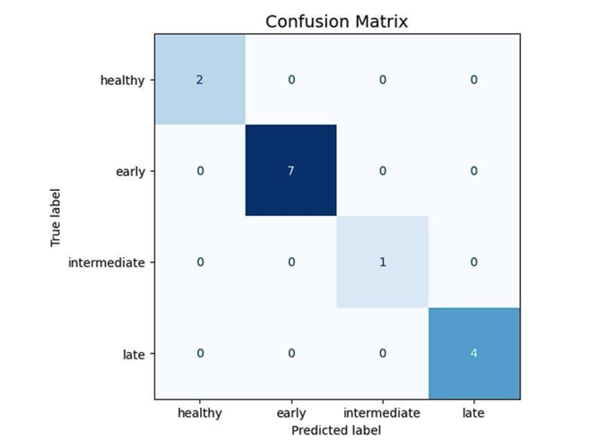
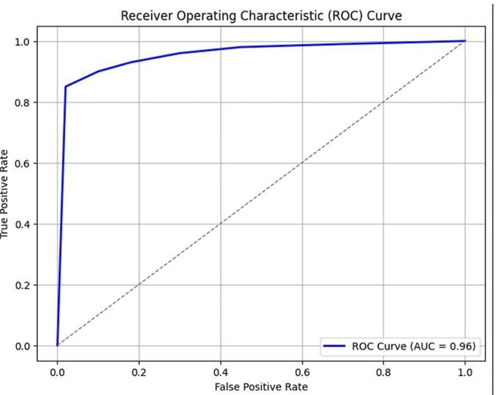
Implementation & Results of First Module
CONFUSION MATRIX Receiver Operating Characteristic(ROC)

Slide 11
Conclusion
The completion of Phase 1 of the project demonstrates the innovation of the hybrid deep learning methodology in this research brings out a good step forward in the automated identification and categorization of AMD.
It works on the mechanism of ViT, EfficientNet, and GANs within the framework addressing some of the critical challenges that occur during diagnosis of AMD, namely class imbalance and constraints with the dataset. Global Context Analysis: Use of a Vision Transformer to Distinguish Complex Spatial Relations and Delicate Patterns from OCT Images.
Local Feature Accuracy: Using EfficientNet for detailed and computationally efficient feature extraction, capturing important retinal characteristics.Data Augmentation with GANs: Generating high-quality synthetic OCT images to enhance dataset diversity, ensuring robust training even for underrepresented stages of AMD.

Slide 12
Conclusion
Hybrid Model Excellence: Combining features of the global and local by utilizing ViT with EfficientNet for an all-rounded and accurate analysis of retinal structures.
It achieved up to excellent scores on accuracy, recall, F1-score, and AUC-ROC metrics with notable improvements in the late-stage detection of AMD. This approach not only reduces the misclassification errors but sets up a scalable, generalizable framework for application in a clinical setting, thereby offering a reliable decision- support tool for earlydetection and effective treatment planning.
Key Components : Data Files, Hybrid Model Framework, Model Training and Testing, Deployment Readiness.

Slide 13
Work for Phase II
The key innovation in the project and phase 2 focuses on providing a much more detailed diagnostic tool to analyze retinal status. Apart from using adjunctive imaging techniques like fundus photography combined with OCT scans, the device records a more significant set of retinal features, thus enhancing its sensitivity 33 toward subtle pathologies. This is likely to do well to improve staging accuracy for AMD and yield higher identification rates for various diseases of the eye.Different sources of data will improve the capability and diagnose properties or characteristics of the model with higher reliability.
In addition to this, the system will further enhance the area of focus on the diagnosis of a variety of retinal and ocular diseases such as diabetic retinopathy and glaucoma, generalize for the new conditions, and extend its ability to diagnose. Trained on multiple datasets, this model is thus robust to a wide range of pathologies, and its applicability to clinical practice in the widest range of retinal diseases is enhanced.

Slide 14
References
Ferris, F. L., Wilkinson, C. P., Bird, A., et al. (2013). Clinical classification of age-related macular degeneration. Ophthalmology, 120(4), 844-851.
Litjens, G., Kooi, T., Bejnordi, B. E., et al. (2017). A survey on deep learning in medical image analysis. Medical Image Analysis, 42, 60-88.
Goodfellow, I., Pouget-Abadie, J., Mirza, M., et al. (2014). Generative adversarial nets. In Advances in Neural Information Processing Systems (pp. 2672-2680).
Dosovitskiy, A., Beyer, L., Kolesnikov, A., et al. (2021). An image is worth 16x16 words: Transformers for image recognition at scale. In International Conference on Learning Representations.

Slide 15
Paper Publication Status
PUBLICATION STATUS: ACCEPTED IN CONFERENCE. NEED TO BE PRESENTED
TITLE OF THE PAPER: AGE-RELATED MACULAR DEGENERATION USING DEEP LEARNING MODELS AND GAN DATA AUGMENTATION
AUTHORS: S. ANANDHI, NANDHAKUMAR S, LAKSHMI KANTH M
NAME OF THE CONFERENCE: INTERNATIONAL CONFERENCE ON MULTIDISCIPILINARY RESEARCH IN EDUCATION SCIENCE AND TECHNOLOGY, GOA, INDIA.
CONFERENCE DATE: 29TH DECEMBER 2024

Slide 16
Thank You

